Slide 1
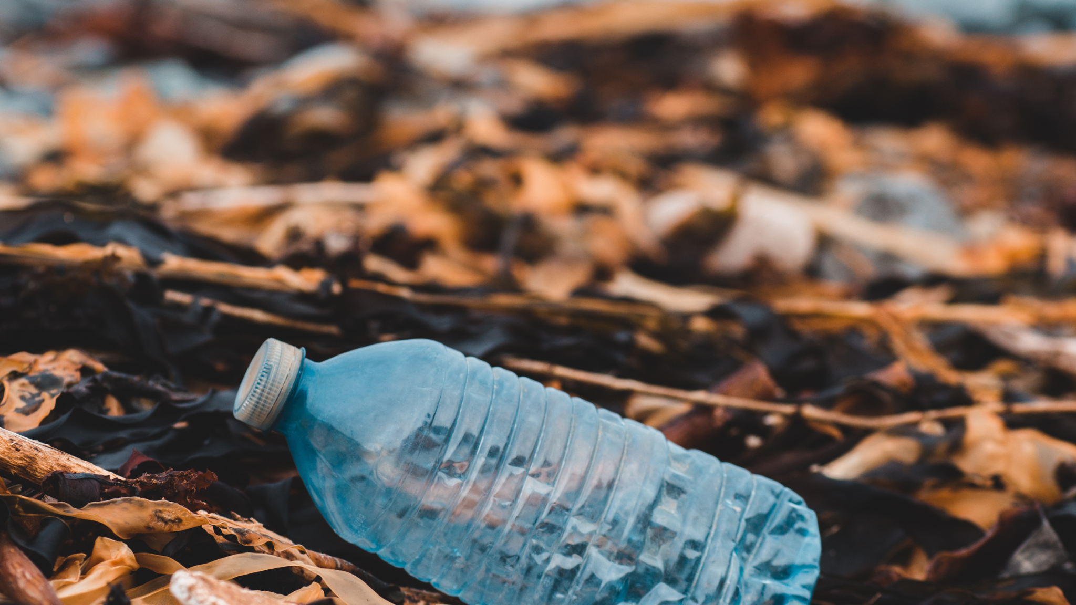
EcoDrop
Reverse Vending Machine
Presented by,
20210204060
20210204064
20210204073
20210204074

Slide 2
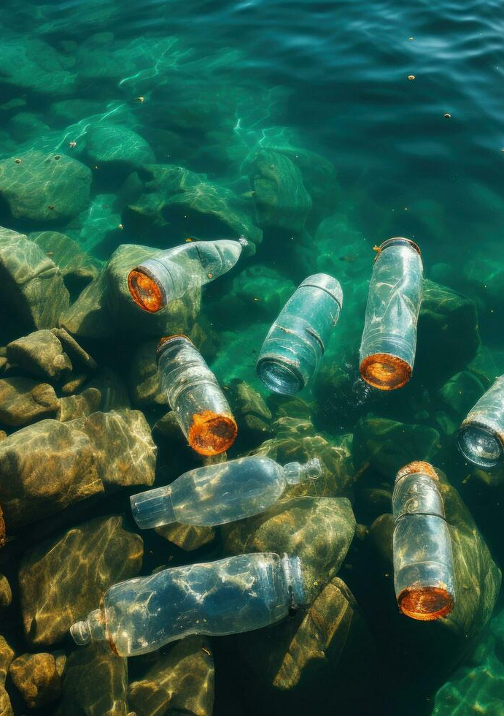
Where Do Plastic Water Bottles End Up?
Bottles found on streets, landfills, floating on oceans, or rivers and on sidewalks lead to littering in cities, clogging water bodies
Each bottle can take up to one thousand years to decompose
Burning of plastic generates toxic emissions , microplastic which can enter the food chain and risk health

Slide 3
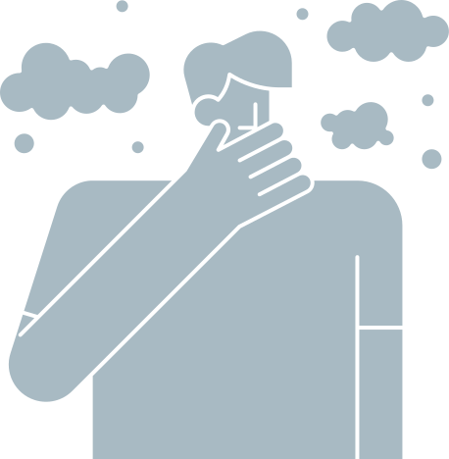
Project Overview
A Reverse Vending Machine is a device that accepts used beverage containers and returns money to the user (the reverse of the typical vending cycle).
The user can insert containers one at a time into the horizontal in-feed system.
This invention relates in general to waste management and recycling the plastic and metal waste (bottles) in the environment.

Slide 4
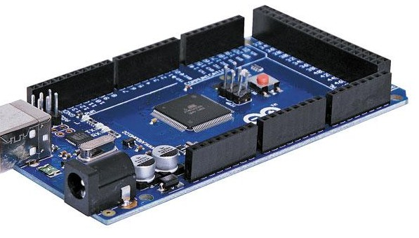
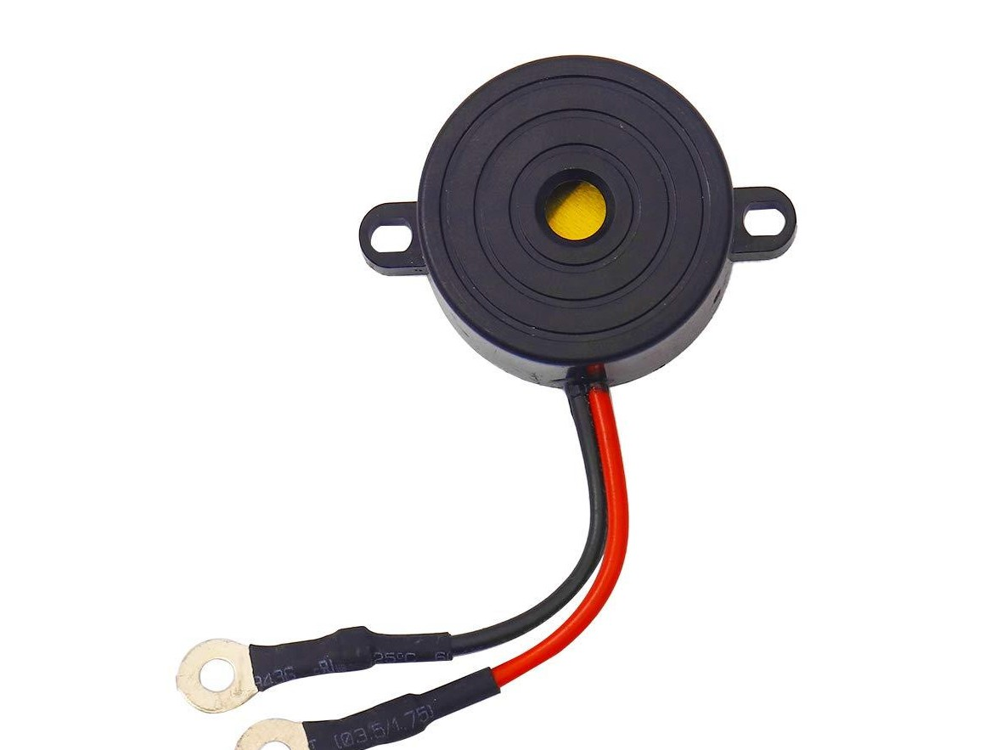
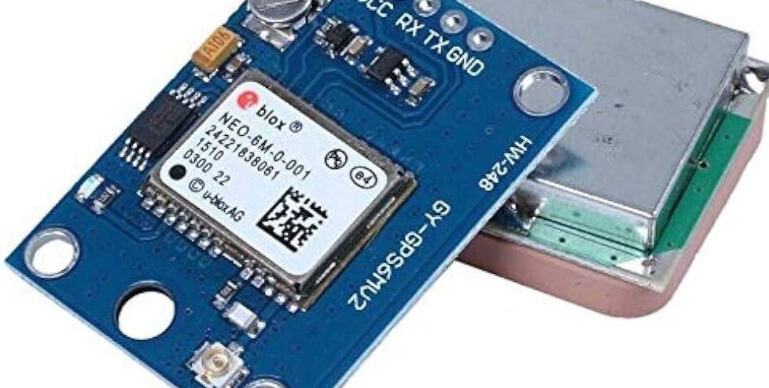
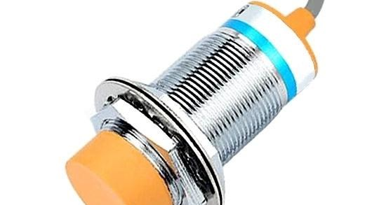
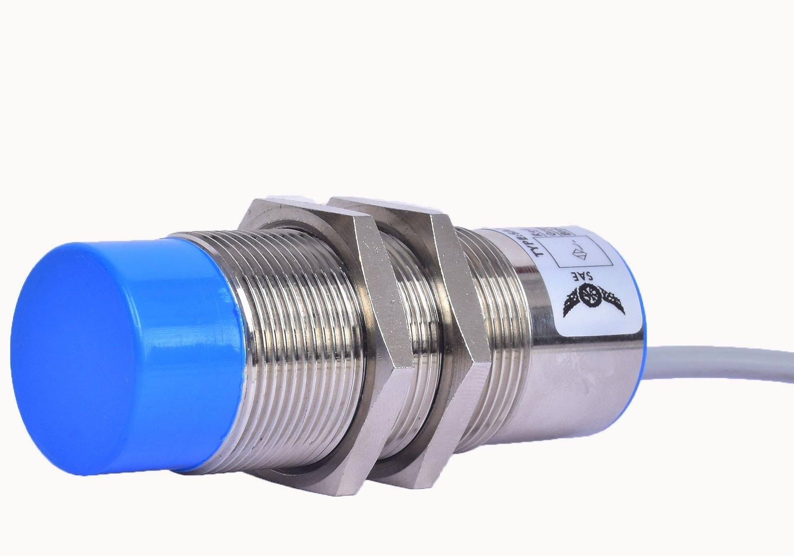
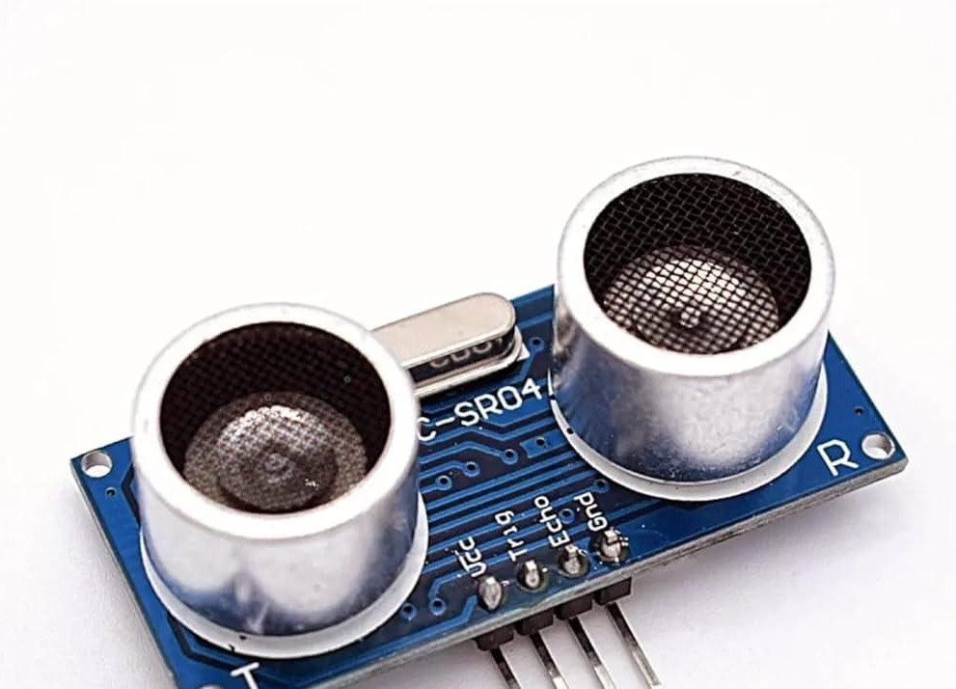
Modern Tools

Slide 5
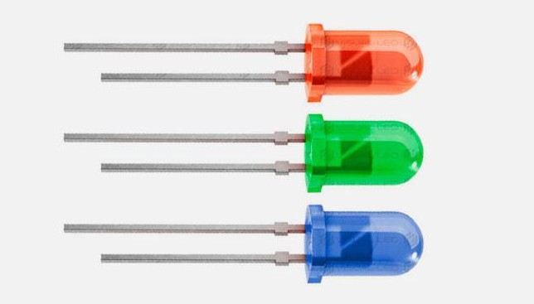
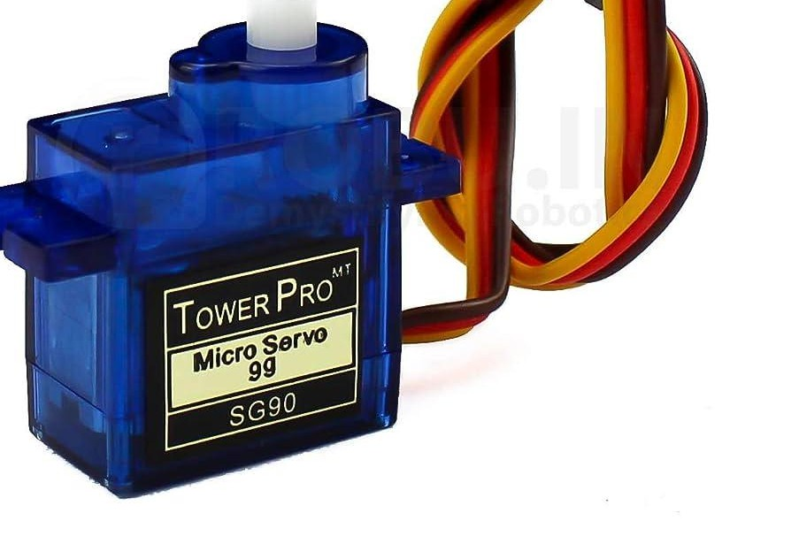
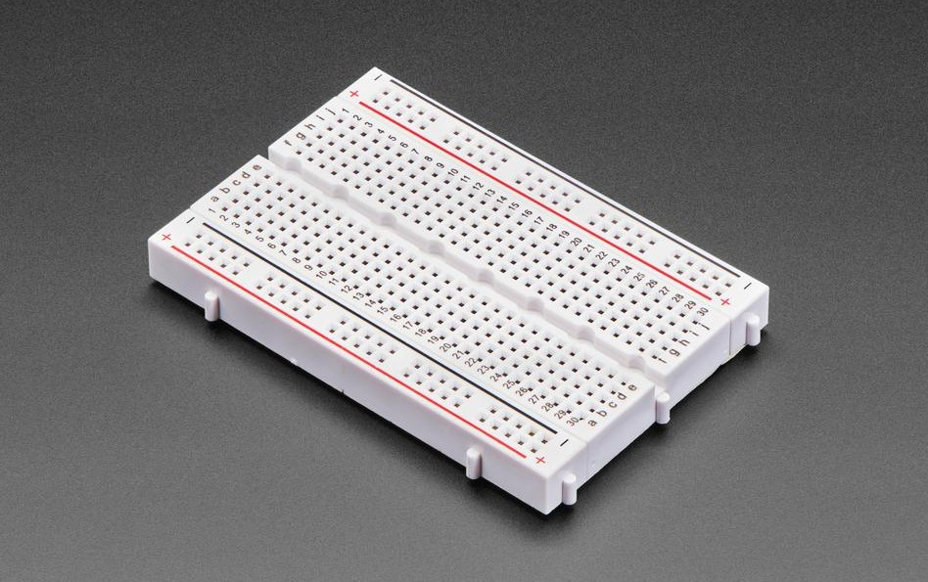
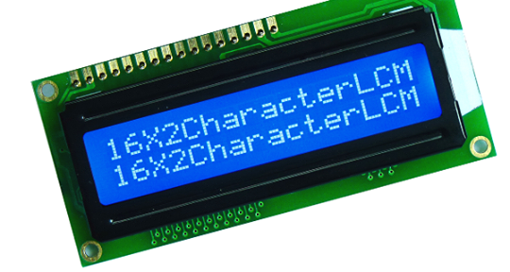
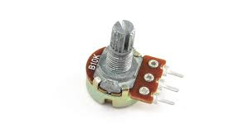
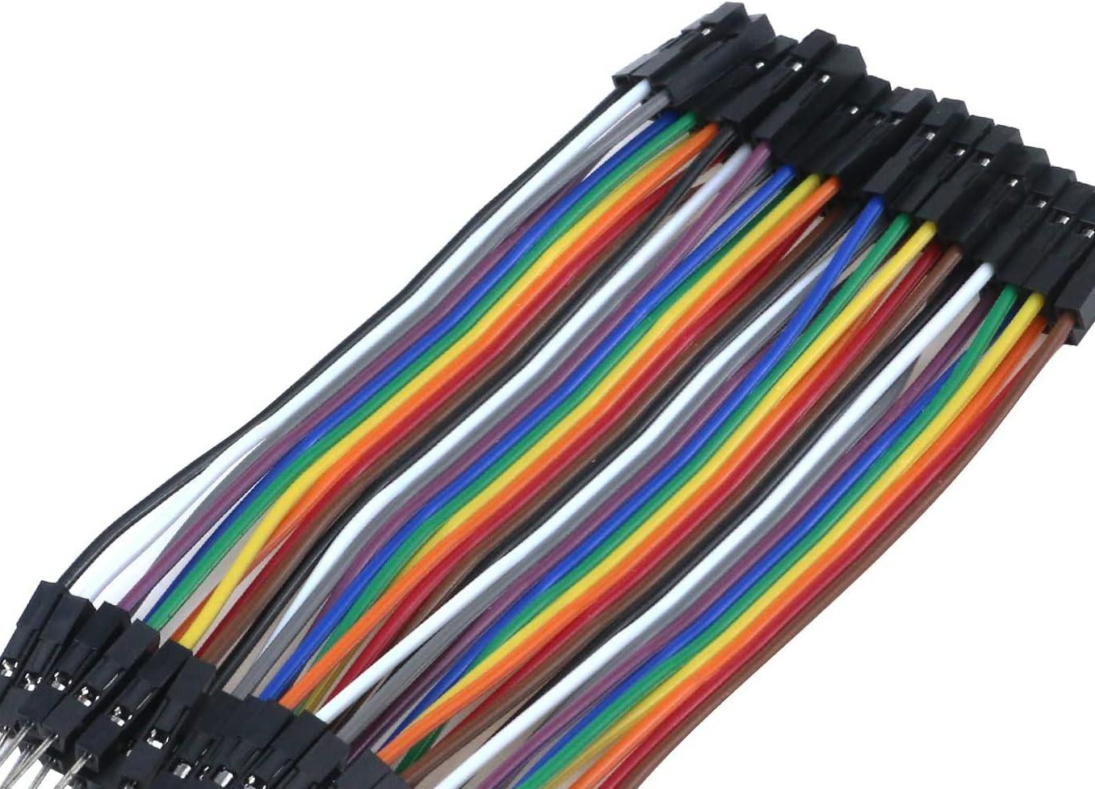
Modern Tools

Slide 6
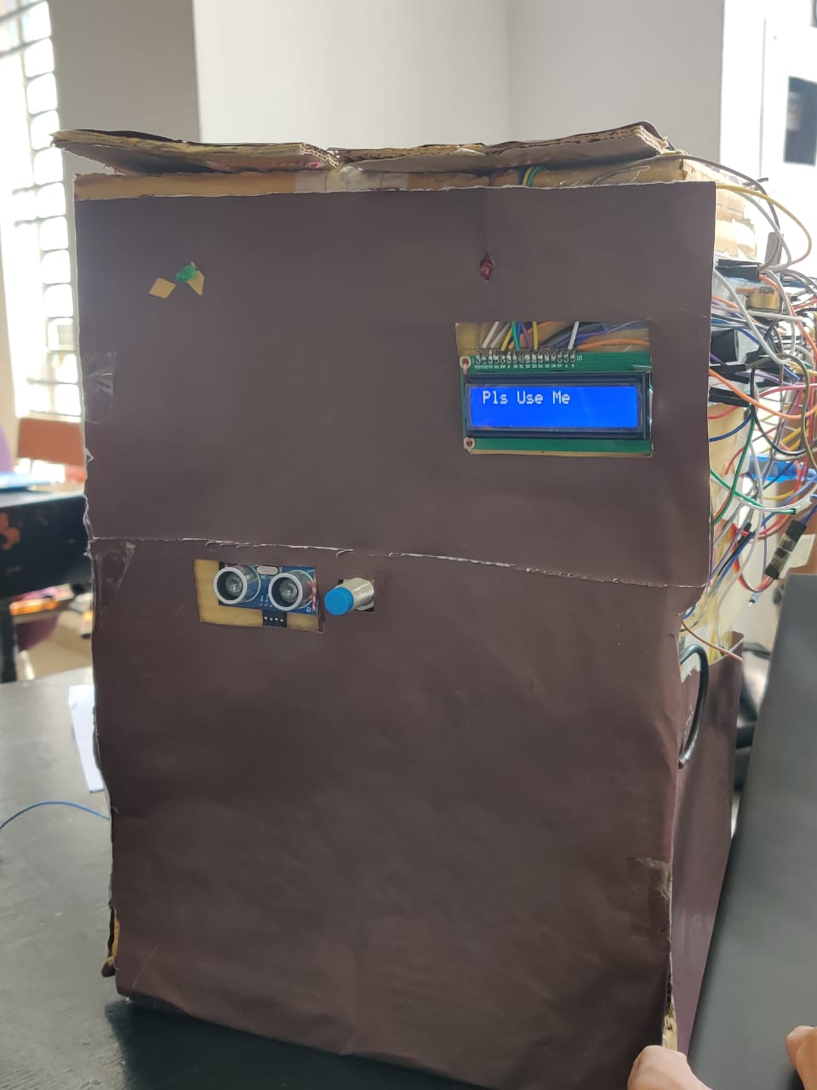
Step 1: Power On and Initial Setup
Step 2: Detecting the Bottle
Step 3: Feedback to User
Step 4: Resetting the Machine

Slide 7

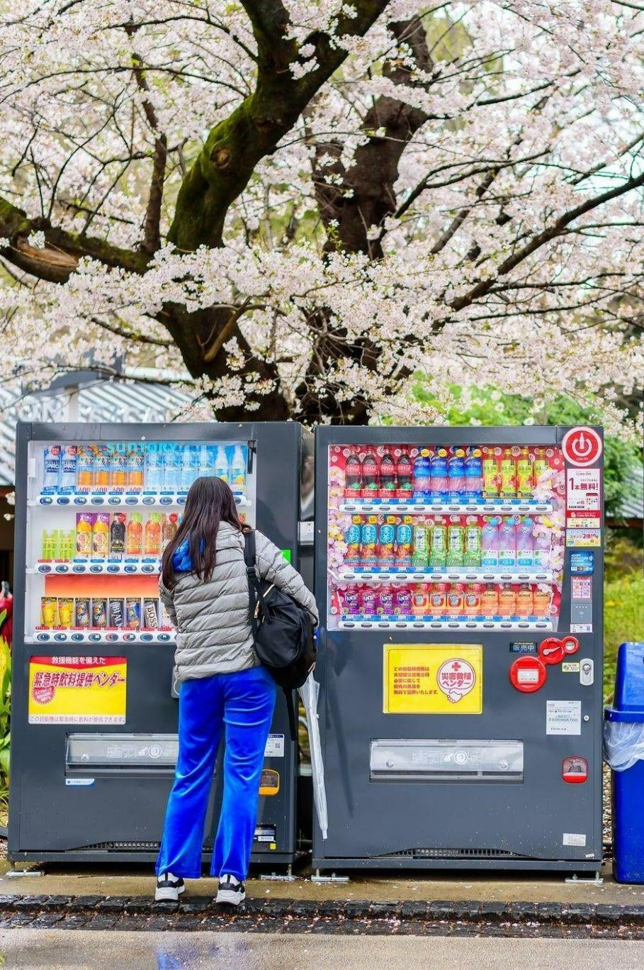
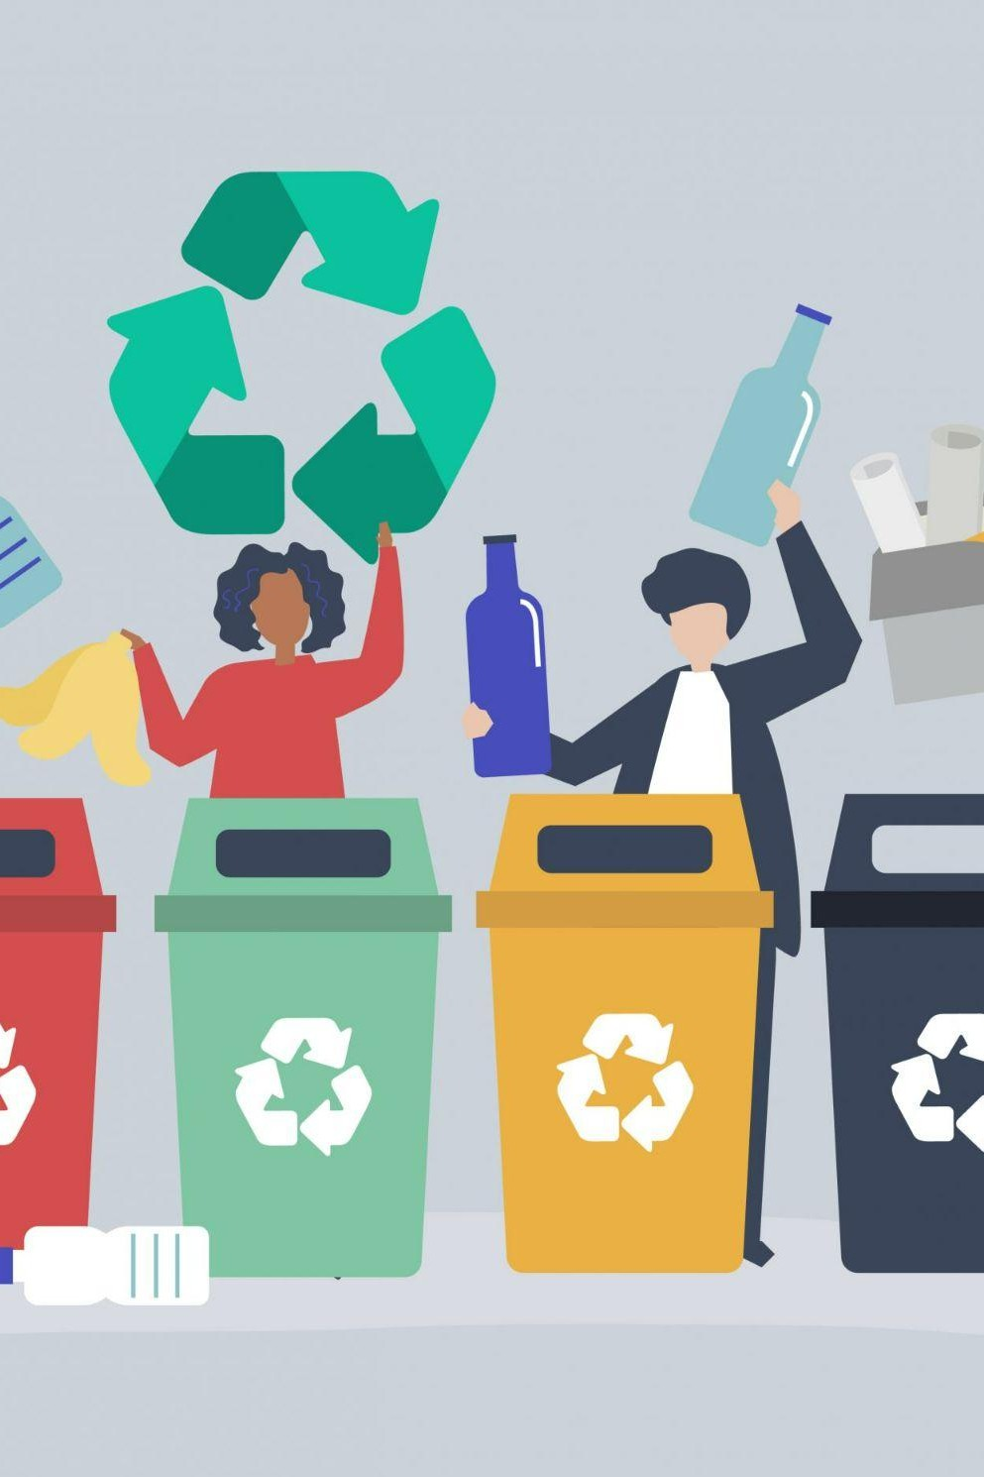
Social & Economic Benefits
Reduces littering in
public spaces and water bodies
Getting coins as reward motivate people to keep
Savings in waste collection, transportation and disposal

Slide 8

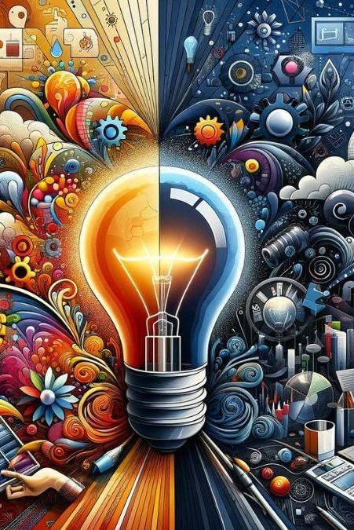

Social & Economic Benefits
Maintenance of RVM can create
employment
Discards negative effect of plastic pollution on ecosystem, wildlife
Dropped plastic cans can be recycled and used to create new product

Slide 9
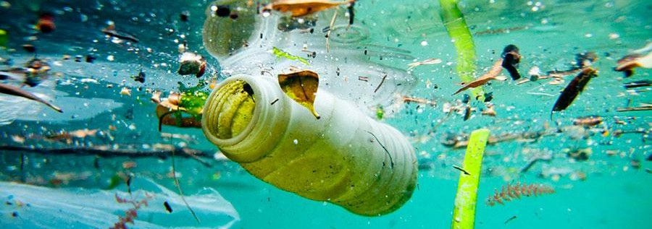
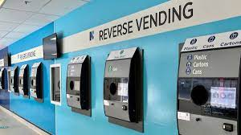
Write Your Topic or Idea
Multiple Stakeholders
TECHNOLOGY PROVIDERS
CONSUMERS
INVESTORS
RETAILERS
MAINTENANCE
ENVIRONMENTAL ORGANIZATIONS

Slide 10
Write Your Topic or Idea
Multidisciplinary Contribution
UX DESIGN
ENVIRONMENTAL SCIENCE
SAFETY AND REGULATION
INDUSTRIAL DESIGN
BUSINESS & MARKETING
ELECTRICAL ENGINEERING

Slide 11
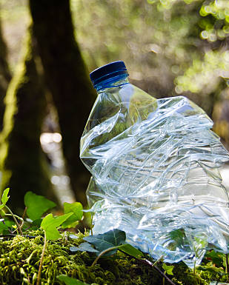
Let’s transform waste into opportunity, one bottle at a time !

Slide 12
THANK YOU

